Slide 1
Back Propagation

Slide 2
Introduction
One type of ANN
Consist of forward and backward algorithm
Forward is employed for determining the output
Backward is used for tuning the weight

Slide 3
ANN Forward Propagation
Example: ADALINE Neural Network
Calculates and of inputs
0
w_{0,3}=0.6
w_{1,3}=0.6
threshold function is step function
1
3
2
w_{2,3}=-0.9
Bias Node

Slide 4
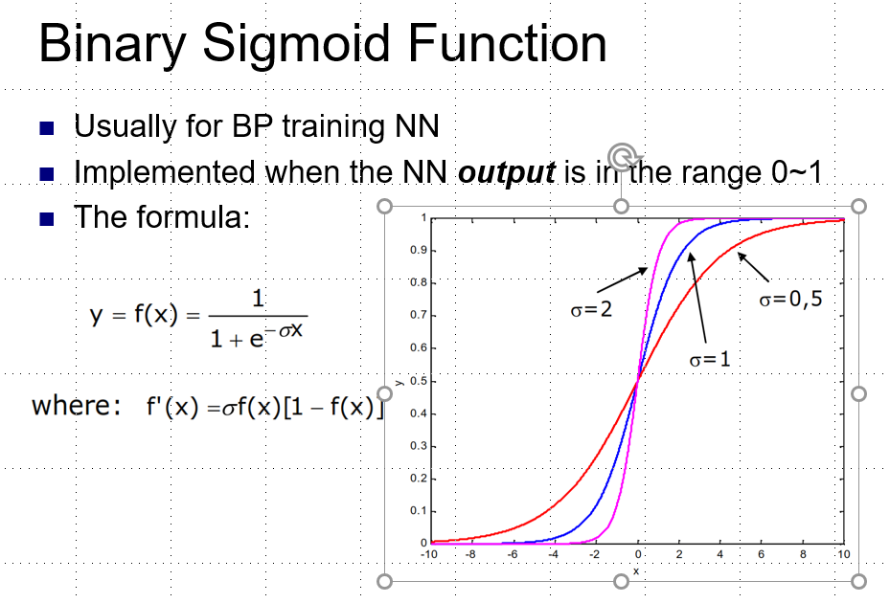
ANN Forward Propagation
Example: Three layer network
Calculates xor of inputs
-4.8
0
2
5.9
5.1
4
4.6
1
3
5.2
-5.2
-3.2
-2.6
-2.7
Bias

Slide 5
ANN Forward Propagation
Input (0,0)
-4.8
0
2
5.9
5.1
4
4.6
1
3
5.2
-5.2
-3.2
-2.6
-2.7
Bias

Slide 6
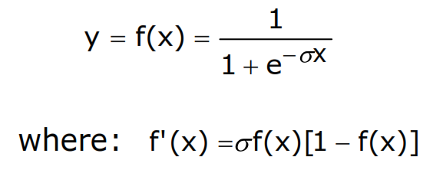
ANN Forward Propagation
Input (0,0)
Node 2 activation is : sum= (-4.8 ⋅ 0)+ (4.6 ⋅ 0) - 2.6)=-2.6
y₂=f(- 2.6)= 1/(1+e^{-(-2.6)})= 0.0691
-4.8
0
2
5.9
5.1
4
4.6
1
3
5.2
-5.2
-3.2
-2.6
-2.7
Bias

Slide 7
ANN Forward Propagation
Input (0,0)
Node 3 activation is : sum= (5.1 ⋅ 0)+ (-5.2 ⋅ 0) - 3.2)=-3.2
y₃=f(-3.2)= 1/(1+e^{-(-3.2)})= 0.0392
y₂=0.0691
-4.8
0
2
5.9
5.1
y₃=0.0392
4
4.6
1
3
5.2
-5.2
-3.2
-2.6
-2.7
Bias

Slide 8
ANN Forward Propagation
Input (0,0)
Node 4 activation is : sum= (5.9 ⋅0.0691)+ (5.2 ⋅ 0.0392) -2.7)=-2.0884
y₄=f(-2.0884)= 1/(1+e^{-(-2.0884)})= 0.1102
y₂=0.0691
-4.8
0
2
5.9
5.1
y₃=0.0392
4
4.6
1
3
5.2
-5.2
-3.2
-2.6
-2.7
Bias

Slide 9
ANN Forward Propagation
Input (0,1)
Node 2 activation is ϕ(4.6 -2.6)= 0.153269
-4.8
0
2
5.9
5.1
4
4.6
1
3
5.2
-5.2
-3.2
-2.6
-2.7
Bias

Slide 10
ANN Forward Propagation
Input (0,1)
Node 3 activation is ϕ(-5.2 -3.2)= 0.000224817
-4.8
0
2
5.9
5.1
4
4.6
1
3
5.2
-5.2
-3.2
-2.6
-2.7
Bias

Slide 11
ANN Forward Propagation
Input (0,1)
Node 4 activation is ϕ(5.9 ⋅ 0.153269 + 5.2 ⋅ 0.000224817 -2.7 )= 0.923992
-4.8
0
2
5.9
5.1
4
4.6
1
3
5.2
-5.2
-3.2
-2.6
-2.7
Bias

Slide 12
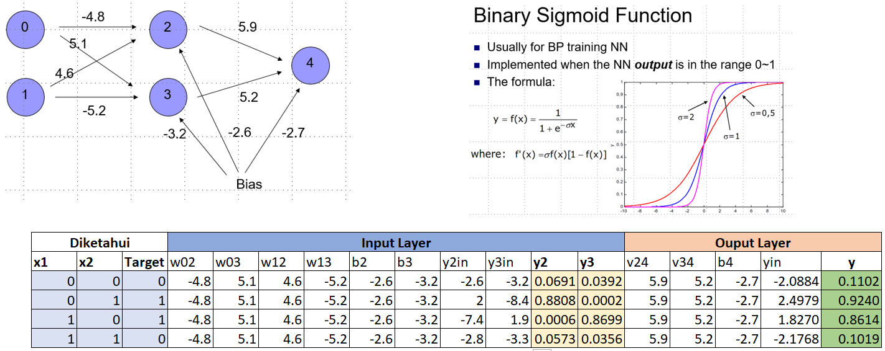
For all Input:

Slide 13
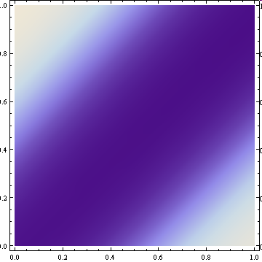
ANN Forward Propagation
Density Plot of Output

Slide 14
ANN Forward Propagation
Network can learn a non-linearly separated set of outputs.
Need to map output (real value) into binary values.

Slide 15
ANN BP Training
Weights are determined by training
Back-propagation:
On given input, compare actual output to desired output.
Adjust weights to output nodes.
Work backwards through the various layers
Start out with initial random weights
Best to keep weights close to zero (<<10⁻⁴)

Slide 16
ANN Training
Weights are determined by training
Need a training set
Should be representative of the problem
During each training epoch:
Submit training set element as input
Calculate the error for the output neurons
Calculate average error during epoch
Adjust weights

Slide 17
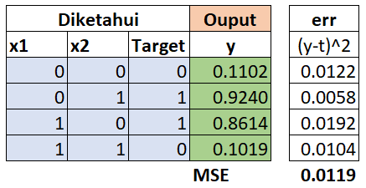
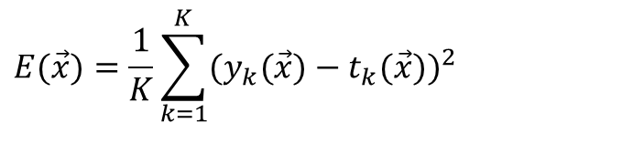
ANN Training
Error is the mean square of differences in output layer
$$E(\vec{x})=\frac{1}{K}\sum_{k=1}^{K}{(y_{k}(\vec{x})−t_{k}(\vec{x})})^{2}$$
y – observed output
t – target output

Slide 18
ANN Training
Error of training epoch is the average of all errors.

Slide 19
ANN Training
Update weights and thresholds using
Weights
Bias
η is a possibly time-dependent factor that should prevent overcorrection

Slide 20
ANN Training
Using a sigmoid function and η=1, we get
sigmoid function f has derivative f ’(t) = f(t)(1- f(t))

Slide 21
ANN Training Example
Start out with random, small weights
x1 | x2 | y
0 | 0 | 0.7116
0 | 1 | 0.6926
1 | 0 | 0.7182
1 | 1 | 0.7029
-0,5
0
2
0.1
-0.5
4
1
1
3
-0.5
1
-1
-0.5
1
Bias

Slide 22
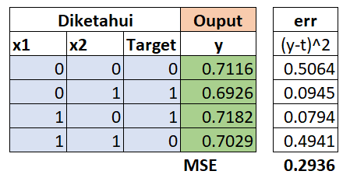
ANN Training Example
x1 | x2 | y | Error
0 | 0 | 0.7116 | 0.7116
0 | 1 | 0.6926 | 0.3074
1 | 0 | 0.7182 | 0.2818
1 | 1 | 0.7029 | 0.7029
0
-0,5
2
0.1
-0.5
1
4
1
3
-0.5
1
-1
-0.5
1
Bias
Average ABS Error is 0.5009
MSE:

Slide 23
ANN Training Example
Calculate the derivative of the error with respect to the weights and bias into the output layer neurons

Slide 24
ANN Training Example
New weights going into node 4
We now obtain δ values for each input separately:
Input 0,0:
δ₄= y₄(0,0) (1- y₄(0,0)) *(0-y₄(0,0)) = -0.1460
Input 0,1:
δ₄= y₄(0,1) (1- y₄(0,1)) *(0-y₄(0,1)) = 0.0655
Input 1,0:
δ₄= y₄(1,0) (1- y₄(1,0)) *(0-y₄(1,0)) = 0.0570
Input 1,1:
δ₄= y₄(1,1) (1- y₄(1,1)) *(0-y₄(1,1)) = -0.1468
Average: δ₄ = - 0.0426
0
-0,5
2
0.1
-0.5
1
4
1
3
-0.5
1
-1
-0.5
1
Bias

Slide 25
ANN Training Example
New weights going into node 4
Average: δ₄ = -0.0426
We can now update the weights going into node 4:
Let’s call: E_{ji} the derivative of the error function with respect to the weight going from neuron i into neuron j.
We do this for every possible input:
E_{4,2} = - output(neuron(2)* δ₄ =-y₂* δ₄
For (0,0): E_{4,2} = -(0.3775)*-0.0426=0.0161
0
-0,5
2
0.1
-0.5
1
4
1
3
-0.5
1
-1
-0.5
1
Bias
x1 | x2 | y2 | y3 | E_{4,2}
0 | 0 | 0.3775 | 0.2689 | 0.0161
0 | 1 | 0.6225 | 0.5000 | 0.0265
1 | 0 | 0.2689 | 0.1824 | 0.0115
1 | 1 | 0.5000 | 0.3775 | 0.0213
 |  |  | Average | 0.0188
New weight from 2 to 4 is now going to be 0.1+0.0188=0.1188

Slide 26
ANN Training Example
Similar to the pervious process, New weights going into node 3-4 with Average: δ₄ = -0.0426
0
-0,5
2
0.1
-0.5
1
4
x1 | x2 | y3 | E₄₃
0 | 0 | 0.2689 | 0.0115
0 | 1 | 0.5000 | 0.0213
1 | 0 | 0.1824 | 0.0078
1 | 1 | 0.3775 | 0.0161
 |  | Average | 0.0141
1
3
-0.5
1
-1
-0.5
1
Bias
New weight from 3 to 4 is now going to be -0.5+0.0141=-0.4859

Slide 27
ANN Training Example
New Bias weights going into node 4:
We also need to change the bias node B₄=1, with average: δ₄ = -0.0426
For (0,0):
E_{4,B}(0,0) = - B₄⋅δ₄ =-1*-0.0426= 0.0426
New weight is 1+0.0426=1.0426
0
-0,5
2
0.1
-0.5
1
4
1
3
-0.5
1
-1
-0.5
1
x1 | x2 | δ₄(x₁,x₂) | E_{4,B}
0 | 0 | -0.1460 | 0.0426
0 | 1 | 0.0655 | 0.0426
1 | 0 | 0.0570 | 0.0426
1 | 1 | -0.1468 | 0.0426
 | Average | -0.0426 | 0.0426
Bias

Slide 28
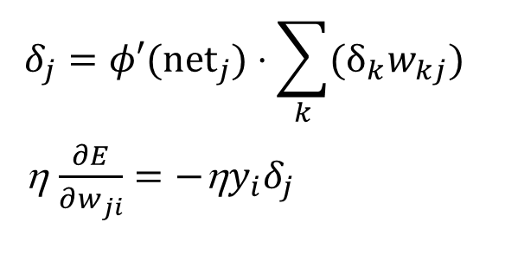
ANN Training Example
We now have adjusted all the weights into the output layer.
Next, we adjust the hidden layer
The target output is given by the delta values of the output layer
More formally:
Assume that j is a hidden neuron
Assume that δ_{k} is the delta-value for an output neuron k.
While the example has only one output neuron, most ANN have more. When we sum over k, this means summing over all output neurons.
w_{kj} is the weight from neuron j into neuron k
$$δ_{j}=φ′(\text{ne}{\text{t}}_{j})⋅\sum_{k}{(δ_{k}w_{kj}})$$ η $\frac{∂E}{∂w_{ji}}=−{\text{η}y}_{i}δ_{j}$

Slide 29
ANN Training Example
We now calculate the updates to the weights of neuron 2.
First, we calculate the δ₂:
We obtain (δ₄ = -0.0426 , y₂= 0.3775 )
δ₂ (0,0) = 0.3775(1-0.3775)(-0.0426*0.1) =- 0.0010
0
-0,5
2
0.1
-0.5
1
4
1
3
-0.5
1
-1
-0.5
1
Bias
x1 | x2 | y2 | y3 | δ₂ | δ₃
0 | 0 | 0.3775 | 0.2689 | -0.0010 | 0.0042
0 | 1 | 0.6225 | 0.5000 | -0.0010 | 0.0053
1 | 0 | 0.2689 | 0.1824 | -0.0008 | 0.0032
1 | 1 | 0.5000 | 0.3775 | -0.0011 | 0.0050
 |  |  | Average | -0.0010 | 0.0044
Set the η=1:

Slide 30
ANN Training Example
d2 | d3 | dw02 | dw12 | dw03 | dw13 | db2 | db3
-0.0010 | 0.0042 | 0.000000 | 0.000000 | 0.000000 | 0.000000 | -0.0009759 | 0.004422
-0.0010 | 0.0053 | 0.000000 | -0.001001 | 0.000000 | 0.005323 | -0.0009759 | 0.004422
-0.0008 | 0.0032 | -0.000837 | 0.000000 | 0.003176 | 0.000000 | -0.0009759 | 0.004422
-0.0011 | 0.0050 | -0.001065 | -0.001065 | 0.005004 | 0.005004 | -0.0009759 | 0.004422
-0.0010 | 0.0044 | -0.0005 | -0.0005 | 0.0020 | 0.0026 | -0.0010 | 0.0044
Call E₂₀ the derivative of E with respect to w₂₀. We use the output activation for the neurons in the previous layer (which happens to be the input layer)
E₂₀ (0,0) = - x₁(0)⋅δ₂ (0,0) = 0* -0.0010=0
E₂₀(0,1) =- x₁(0)⋅δ₂ (0,1) = 0* -0.0010 =0 E₂₀(1,0) = - x₁(1)⋅δ₂ (1,0) = -1* -0.0008 =0.0008
E₂₀(1,1) = - x₁(1)⋅δ₂ (1,1) = -1* -0.0011=0.0011
The average is 0.0005 and the new weight (W₂₀)=-0.5+0.0005)=-0.4995
0
-0,5
2
0.1
-0.5
1
4
1
3
-0.5
1
-1
-0.5
1
Bias

Slide 31
ANN Training Example
Call E₂₁, E₃₀ and E₃₁ as well as their respective wegihts:
0
-0,5
2
0.1
-0.5
1
4
x1 | x2 | δ₂ | δ₃ | E₂₁ | E₃₀ | E₃₁
0 | 0 | -0.0010 | 0.0042 | 0.000000 | 0.000000 | 0.000000
0 | 1 | -0.0010 | 0.0053 | 0.001001 | 0.000000 | -0.005323
1 | 0 | -0.0008 | 0.0032 | 0.000000 | -0.003176 | 0.000000
1 | 1 | -0.0011 | 0.0050 | 0.001065 | -0.005004 | -0.005004
Average |  | -0.0010 | 0.0044 | 0.0005 | -0.0020 | -0.0026
1
3
-0.5
1
-1
-0.5
1
Bias
Finally the new weights are
W₂₁= 1+0.0005 = 1.0005
W₃₀=-0.5-0.0020 = -0.5020
W₃₁= 1-0.0026 = 0.9974

Slide 32
ANN Training Example
Call E_{2B} the derivative of E with respect to B₂ and B₃.
E_{2B} (0,0) = - -0.5 ⋅δ₂ (0,0) = -0.0005
E_{3B} (0,0) = - -0.5 ⋅δ₂ (0,0) = 0.004187
For all E_{jB:}
The new biases are:
B₂ = -0.5 + -0.0005=-0.5005
B₃ = -1+ 0.0044= -0.9956
0
-0,5
2
0.1
-0.5
1
4
1
3
-0.5
1
-1
-0.5
1
x1 | x2 | δ₂ | δ₃ | E_{2B} | E_{3B}
0 | 0 | -0.0010 | 0.0042 | -0.0005 | 0.004187
0 | 1 | -0.0010 | 0.0053 | -0.0005 | 0.005323
1 | 0 | -0.0008 | 0.0032 | -0.00042 | 0.003176
1 | 1 | -0.0011 | 0.0050 | -0.00053 | 0.005004
Average |  | -0.0010 | 0.0044 | -0.0005 | 0.0044
Bias

Slide 33
ANN Training Example
All process is repeated until reaching the appropriate error (typically <0.0001)
0
-0,5
2
0.1
-0.5
1
4
1
3
-0.5
1
-1
-0.5
1
Bias

Slide 34
ANN Training
ANN Back-propagation is an empirical algorithm

Slide 35
ANN Training
XOR is too simple an example, since quality of ANN is measured on a finite sets of inputs.
More relevant are ANN that are trained on a training set and unleashed on real data

Slide 36
ANN Training
Need to measure effectiveness of training
Need training sets
Need test sets.
There can be no interaction between test sets and training sets.
Example of a Mistake:
Train ANN on training set.
Test ANN on test set.
Results are poor.
Go back to training ANN.
After this, there is no assurance that ANN will work well in practice.
In a subtle way, the test set has become part of the training set.

Slide 37
ANN Training
Convergence
ANN back propagation uses gradient decent.
Naïve implementations can
overcorrect weights
undercorrect weights
In either case, convergence can be poor
Stuck in the wrong place
ANN starts with random weights and improves them
If improvement stops, we stop algorithm
No guarantee that we found the best set of weights
Could be stuck in a local minimum

Slide 38
ANN Training
Overtraining
An ANN can be made to work too well on a training set
But loose performance on test sets
Training set
Test set
Performance
Training time

Slide 39
ANN Training
Overtraining
Assume we want to separate the red from the green dots.
Eventually, the network will learn to do well in the training case
But have learnt only the particularities of our training set

Slide 40
ANN Training
Overtraining

Slide 41
ANN Training
Improving Convergence
Many Operations Research Tools apply
Simulated annealing
Sophisticated gradient descent

Slide 42
ANN Design
ANN is a largely empirical study
“Seems to work in almost all cases that we know about”
Known to be statistical pattern analysis

Slide 43
ANN Design Review
Number of layers
Apparently, three layers is almost always good enough and better than four layers.
Also: fewer layers are faster in execution and training
How many hidden nodes?
Many hidden nodes allow to learn more complicated patterns
Because of overtraining, almost always best to set the number of hidden nodes too low and then increase their numbers.

Slide 44
ANN Design Review
Interpreting Output
ANN’s output neurons do not give binary values.
Good or bad
Need to define what is an accept.
Can indicate n degrees of certainty with n-1 output neurons.
Number of firing output neurons is degree of certainty

Slide 45
ANN Applications
Pattern recognition
Network attacks
Breast cancer
…
handwriting recognition
Pattern completion
Auto-association
ANN trained to reproduce input as output
Noise reduction
Compression
Finding anomalies
Time Series Completion

Slide 46
ANN Future
ANNs can do some things really well
They lack in structure found in most natural neural networks

Slide 47
Pseudo-Code
phi – activation function
phid – derivative of activation function

Slide 48
Pseudo-Code
Forward Propagation:
Input nodes i, given input x_{i}:
foreach inputnode i
output_{i} = x_{i}
Hidden layer nodes j
foreach hiddenneuron j
output_{j} = ∑_{i} phi(w_{ji}⋅output_{i})
Output layer neurons k
foreach outputneuron k
output_{k} = ∑_{k} phi(w_{kj}⋅output_{j})

Slide 49
Pseudo-Code
ActivateLayer(input,output)
foreach i inputneuron
calculate output_{i}
foreach j hiddenneuron
calculate output_{j}
foreach k hiddenneuron
calculate output_{k}
output = {output_{k}}

Slide 50
Pseudo-Code
Output Error
Error() {
foreach input in InputSet
Error_{input} = ∑_{k output neuron} (target_{k}-output_{k})²
return Average(Error_{input},InputSet)

Slide 51
Pseudo-Code
Gradient Calculation
We calculate the gradient of the error with respect to a given weight w_{kj}.
The gradient is the average of the gradients for all inputs.
Calculation proceeds from the output layer to the hidden layer

Slide 52
Pseudo-Code
For each output neuron k calculate:
For each output neuron k calculate and hidden layer neuron j calculate:

Slide 53
Pseudo-Code
For each hidden neuron j calculate:
For each hidden neuron j and each input neuron i calculate:

Slide 54
Pseudo-Code
These calculations were done for a single input.
Now calculate the average gradient over all inputs (and for all weights).
You also need to calculate the gradients for the bias weights and average them.

Slide 55
Pseudo-Code
Naïve back-propagation code:
Initialize weights to a small random value (between -1 and 1)
For a maximum number of iterations do
Calculate average error for all input. If error is smaller than tolerance, exit.
For each input, calculate the gradients for all weights, including bias weights and average them.
If length of gradient vector is smaller than a small value, then stop.
Otherwise:
Modify all weights by adding a negative multiple of the gradient to the weights.

Slide 56
Pseudo-Code
This naïve algorithm has problems with convergence and should only be used for toy problems.

Slide 57
ANN Training Example 2
Start out with random, small weights
1
Node 0: x₀
Node 1: x₁
Node 2: o₂ = ϕ(x₀ + x₁ -0.5)
Node 3: o₃ = ϕ(0.5 x₁ -1)
Node 4: o₄ = ϕ(0.3 o₂ – 0.7 o₃ + 1)
0
2
0.3
0
4
1
1
3
-0.7
0.5
-1
-0.5
1
Bias

Slide 58
ANN Training Example 2
Calculate outputs
1
x1 | x2 | y=o₄
0 | 0 | 0.7160
0 | 1 | 0.7155
1 | 0 | 0.7308
1 | 1 | 0.7273
0
2
0.3
0
4
1
1
3
-0.7
0.5
-1
-0.5
1
Bias

Slide 59
ANN Training Example 2
Calculate average error to be E = 0.14939
0
1
2
0.3
x₀ | x₁ | y | t | E=(y-t)²/2
0 | 0 | 0.7160 | 0 | 0.2564
0 | 1 | 0.7155 | 1 | 0.0405
1 | 0 | 0.7308 | 1 | 0.0362
1 | 1 | 0.7273 | 0 | 0.264487
0
1
4
1
0.5
3
-0.7
-1
-0.5
1
Bias

Slide 60
ANN Training Example 2
Calculate the change for node 4
0
1
2
0.3
0
1
4
1
3
-0.7
0.5
-1
-0.5
1
Bias
Need to calculate net₄, the weighted input of all input into node 4
net₄(x₀,x₁) = 0.3 o₂(x₀,x₁) – 0.7 o₃(x0,x1) + 1
net₄ = (net₄(0,0) + net₄(0,1) + net₄(1,0) + net₄(1,1))/4
This gives 0.956734

Slide 61
ANN Training Example 2
Calculate the change for node 4
0
1
2
0.3
0
1
4
1
3
-0.7
0.5
-1
-0.5
1
Bias
We now calculate
δ₄(0,0) = ϕ’(net₄(0,0)(0 - o₄(0,0)) = - 0.14588
δ₄(0,1) = ϕ’(net4(0,1)(1 - o4(0,1)) = 0.05790
δ₄(1,1) = ϕ’(net4(1,0)(0 - o4(1,0)) = 0.05297
δ₄(1,1) = ϕ’(net4(1,1)(0 - o4(1,1)) = -0.14425
On average δ₄ = -0.044741

Slide 62
ANN Training Example 2
Calculate the change for node 4
0
1
2
0.3
0
1
4
1
3
-0.7
0.5
-1
-0.5
1
δ₄ = -0.044741
We can now update the weights for node 4
E_{4,2}(0,0) = -o₂(0,0)* δ₄ =0.01689
E_{4,2}(0,1) = -o₂(0,1)* δ₄ = 0.02785
E_{4,2}(1,0) = -o₂(1,0)* δ₄ = 0.02785
E_{4,2}(0,0) = -o₂(0,0)* δ₄ =0.03658
with average 0.00708
Bias

Slide 63
ANN Training Example 2
Calculate the change for node 4
0
1
2
0.3
0
1
4
1
3
-0.7
0.5
-1
-0.5
1
Bias
E_{4,2} = 0.00708
Therefore, new weight w₄₂ is 0.2993

